Slide 1
SAP S/4HANA as a Core for Business Transformation Industry 4.0 Impossible is Pos­sible
Oleg Laktyushin
CIO Metalloinvest Management Company LLC
Dmitry Toporov
MD Accenture CNR
Notes:
Применить эту картинку на все

Slide 2
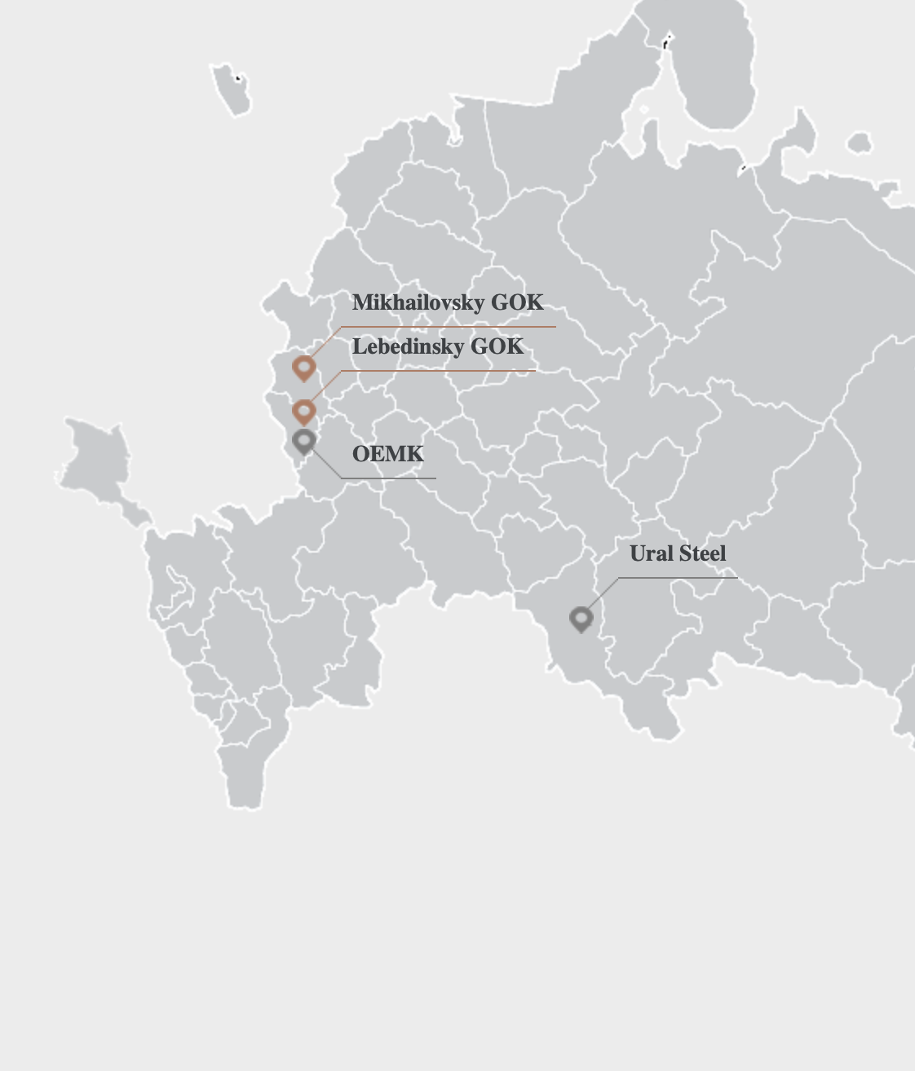
Metalloinvest Company Profile
Metalloinvest is a leading global producer and supplier of HBI and iron ore products, and a regional producer of high quality steel.
Metalloinvest extracts iron ore from the second largest measured iron ore reserve base in the world with approximately 14.1 billion tonnes of proven and probable reserves on a JORC (IMC Montan) equivalent basis and about 140 years of reserve life
The Company’s Mining Segment comprises Lebedinsky GOK and Mikhailovsky GOK, the two largest iron ore mining and processing facilities (by production volume) in Russia.
The Company's Steel Segment comprises OEMK (Oskol Electrometallurgical Plant), Ural Steel and Ural Scrap Company. Metalloinvest is the fifth-largest steel producer in Russia by volume.
Employees – over 48 000
Operating revenue in 2017 - 6.2 billion dollars
Notes:
Mining Segment
The Company is a global-scale producer of beneficiated iron ore products, processing the majority of its primary iron ore concentrate products into high added-value products, such as iron ore pellets and HBI/DRI. In 2016, Metalloinvest accounted for 39% of Russia’s iron ore concentrate and sintering ore output, 59% of iron ore pellets and 100% of HBI and metallised pellets
Steel Segment
The Company's Steel Segment comprises OEMK (Oskol Electrometallurgical Plant), Ural Steel and Ural Scrap Company. The Company is one of the leading regional producers of steel, accounting for approximately 7% of total steel production in Russia. OEMK and Ural Steel together produce over 2,000 grades of steel. Metalloinvest is the fifth-largest steel producer in Russia by volume*.

Slide 3
Industry 4.0 Program Overview
2015
2016
2017
2018
2019
Industry 4.0
SAP Implementation
Business Transformation
Change Management
Duration of the Program is 5 years.
Scope of the project includes 2 waves:
Mining Segment(Lebedinsky GOK, Mikhailovsky GOK)
Steel Segment(OEMK (Oskol Electrometallurgical Plant), Ural Steel)
Main goals:
SAP S/4 HANA Implementation is unified company platform
Improving the efficiency and manageability of the company
Unification of business processes
Creation of Shared Service Center (Metalloinvest Corporate Service)
Reduce operating costs

Slide 4

Industry 4.0 S/4HANA Implementation Roadmap
2017 |  |  |  |  |  | 2018 |  |  |  |  |  |  |  |  |  |  |  | 2019
Jul. | Aug. | Sept. | Oct. | Nov. | Dec. | Jan. | Feb. | Mar. | Apr. | May | Jun. | Jul. | Aug. | Sept. | Oct. | Nov. | Dec. | Jan. | Feb. | Mar. | Apr. | May | Jun. | Jul. | Aug. | Sept. | Oct. | Nov. | Dec.
SAP S/4HANA Wave 1, Analytics
SAP S/4HANA Wave 2
Budgeting, Sales and Operation Planning Wave 1
Sales and Operation Planning Wave 2
SAP HCM Wave 1
SAP HCM Wave 2
WHY
S/4HANA 1709?
SAP S/4HANA 1709
SAP HANA 2.0
SAP MDG for S/4HANA 9.0
SAP HCM
SAP Access control for S/4HANA
SAP S/4HANA Finance
SAP BW
SAP Process Orchestration 7.5
SAP Solution Manager 7.2
The Program were implemented in standard ASAP methodology.
Realization is splitted – 1st wave Mining Segment, 2nd wave Steel Segment
Main rule for additional functions - Keep it Standard!

Slide 5
SAP Support Channels
+
Enterprise Support
SAP S/4HANA Customer Care
28
4
7
13,5
Meetings on weekly
base with Customer
Care Support Team
Info-sessions
Early Knowledge
Transfer
Enterprise
Support Services
Done
Times Faster
CPTD Performance
after BPPO Service
ES Services:
CQC Custom Code Maintainability Check
CQC for Implementation (Analysis session)
CQC Business Process Performance Optimization
CQC Security Optimization
CQC Technical Performance Optimization
CQC Going Live Support
CQC for Implementation (Verification session)
5
Showstopper incidents were closed
during Cut-Over period

Slide 6
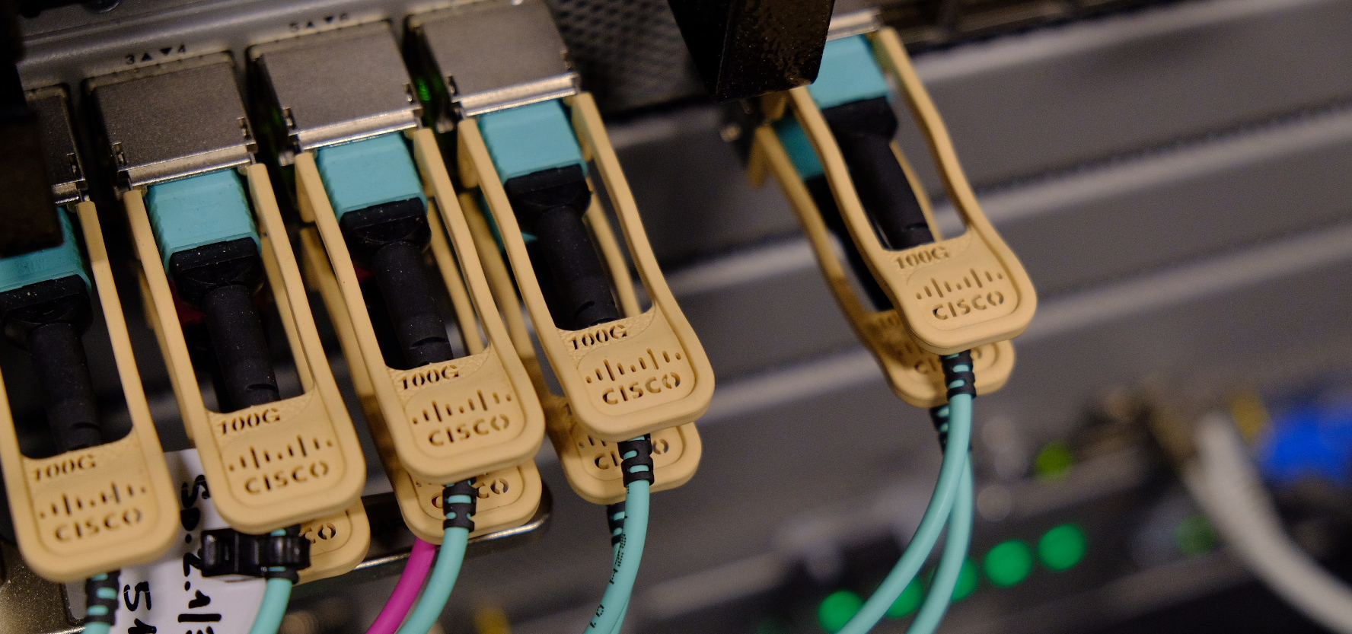
HANA 2.0 ready Data Center
Key features:
Latest version of SAP S/4 HANA 1709*
Latest version of HANA 2.0
More than 10 production systems. 67 SAP systems.
More than 40 third party systems integrated.
Hybrid architecture – Database servers on IBM Power, Application servers on x86.
SDN solution - Cisco ACI
Tier-3 ready Data Center
Data Center #1
Data Center #2
x86
x86
IBM POWER
IBM POWER
SAP HANA
System Replication
Database servers (LPAR)
Storage Replication
Application servers (VM)
Сisco ACI Multipod
* - latest version at the time of Go-Live

Slide 7
Functional Scope
S/4HANA Finance
Accounting, Taxes, IFRS
Treasury & Risk Management:
Analyze: Credit Risk Analyzer
Transaction Manager: Money Market, Securities, Trade Finance, Foreign Exchange, Derivatives
Financial Supply Chain Management: Cash Management, Cash and Liquidity Management, Liquidity Planning, Bank Communication Management
Controlling:
Product costing, Material Ledger, Overhead Cost Controlling, Profitability Analysis
PS/Program Portfolio Management*:
Project Planning
Project Execution
Integration with Primavera
Production Planning:
Master Data, LO-VC(BRF+), Production Planning, Shop Flor Control, MES Integration
Plant Maintenance:
Master Data
Notification
Maintenance Orders
Procurement & Inventory:
Master Data
MRP New
PO
Sales and Distribution:
LO-VC*
Formula Based Pricing based on BRF+
Outbound Delivery online integrated with MES
Budgeting:
70’s Budgeting form based on SAP BPC
Analytics:
10 CDS Views in S/4HANA, 29 reports in SAP BW
RCM:
Legal Contracts integrated with Procurement/Sales/TRM and external workflow system
(*) - additional functionality will be implemented in Wave 2

Slide 8
Industry 4.0 – S/4HANA & MES Integration
Daily update of mining operations
Unified Product Definition Library (VC/BRF+)
Online
Daily
Weekly
Monthly
C-level reports
Product
Costing
S4HANA
Production
Order
Order
confirm
Outbound
Delivery
Sales Order
Configuration
Production
Planning
SFP
FG
Inventory
Product
Definition
Production
Scheduling
Integration Layer
MES Level
Sales
Analysis
Production
Execution
Production
Quality
Load/Haul
ROM
Stockpile
Crush
Process
Product
Stockpile

Slide 9
Industry 4.0 – Integration BPC + S&OP
S&OP Model
Budget model
BPC
18 M/ 3Y
100 Products
250 Resources
150 Customers
130 RWS \ Harbors
Production Plan
8 Main Budget Forms
180 Budget Forms in Total
Sales Plan
Inventory Plan
S/4HANA
Sales History
Sales Contracts
Actuals
Approved Budget Scenario
Capacity Availability
One source for Master Data
MM PUR
PP
CO-PC
SD
PM
CO-OM

Slide 10

SAP HCM
2017 |  |  |  |  |  | 2018 |  |  |  |  |  |  |  |  |  |  |  | 2019
jul | aug | sep | oct | nov | dec | jan | feb | mar | apr | may | jun | jul | aug | sep | oct | nov | dec | jan | feb | mar | apr | may | jun | jul | aug | sep | oct | nov | dec
SAP HCM Wave 1
SAP HCM Wave 2
Payroll for
Management levels
24 000
51
from 13 to 6
employees is performed in SAP HCM
Organizational unit were unified
in Organizational structure
Next Steps:
SAP HCM Wave 2 Implementation for Steel Segment
Self-services for employees based on SAP ESS and HR-bot(Viber, WhatsApp, Telegram)
Talent Management based on SAP Success Factors

Slide 11
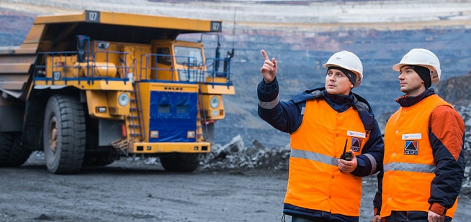
Plant Maintenance Business Transformation
Reduce Unplanned Downtime
Improve control and process transparency
Manage maintenance cost
Improve material planning
1550
16000+
PM employees work in SAP S/4HANA on daily basis
Maintenance Orders planned and executed each month
Current Result:
Unified PM Master Data for Mining Segment
New Organizational structure for Plant Maintenance for Mining Segment
1.2 million historical Maintenance Orders migrate to SAP S/4HANA
Next Steps:
SAP S/4 Implementation for PM in Steel Segment
Unified PM Master Data and Organizational Structure for Steel Segment
Mobile Plant Maintenance

Slide 12
Procurement
Transformation Initiatives
Operational Model (definition, piloting, full implementation)
Process review for Service Procurement
Develop sourcing capabilities
Contracting procedure optimization
Key Achievements
New operational procurement model (FMB pilot launched)
Centralized model to manage service procurement
Sourcing strategy templates, action plans to develop sourcing category
Balanced Contracting Procedure (Simplified Process for small deals)
Next Steps:
FMB model implementation
Stabilization of new processes
New digital ways to buyer-supplier interaction

Slide 13
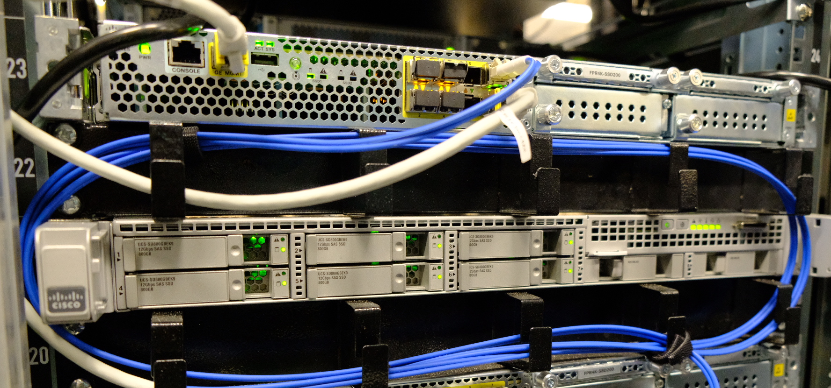
SAP S/4HANA as Digital Core
Get more business value through usage of S/4HANA digital components for Procurement and Accounting
Fine tuning of Business Process
Keep Infrastructure TCO balanced while allowing business get access to data
Cloud Platform for digital pilots
Business Process Optimization
Infrastructure Cost Optimization
SAP
Process
Mining
SAP Quantity contract consumption
SAP Predict Arrival of Stock in Transit
SAP
Cash
Application
DATA
Aging
SAP
Cloud
Platform

Slide 14
Next Steps
1st of January 2019
SAP HCM Go Live for OEMK (Oskol Electrometallurgical Plant), Ural Steel
1st of July 2019
SAP S/4 HANA Go Live for OEMK (Oskol Electrometallurgical Plant), Ural Steel
1st of October 2019
SAP BPC Go Live 2nd Wave
Sales and Operation Planning for OEMK (Oskol Electrometallurgical Plant), Ural Steel

